Slide 1
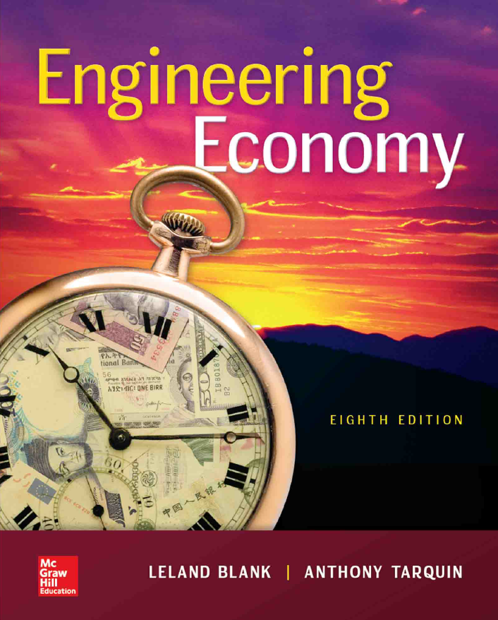

Chapter 14
Effects of Inflation
Lecture slides to accompany
Engineering Economy
8th edition
Leland Blank
Anthony Tarquin

Slide 2
LEARNING OUTCOMES
Understand inflation/deflation
Calculate PW of cash flows with inflation
Calculate FW with inflation considered
Calculate AW with inflation considered
14-<number>

Slide 3
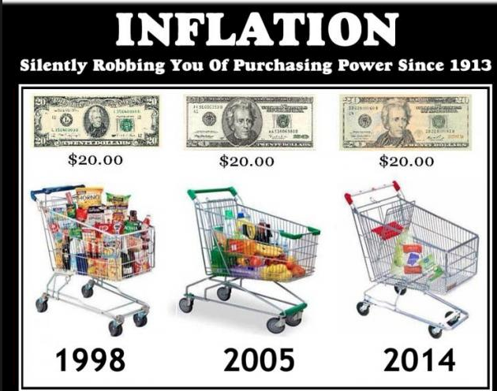
Understanding Inflation
14-<number>

Slide 4
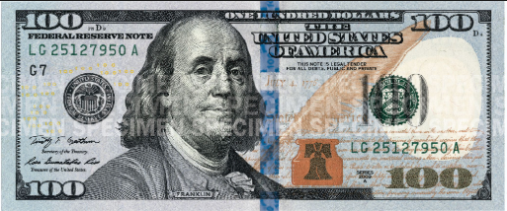

Actual $ vs. Constant $
Actual $ : expressed in the amount of _______ that you are expected to have at year n
Constant $ : expressed in the amount of _____________ ______ as of year __ that you are expected to have at year n
$100(Actual)
$100
0
n
year
$100(Constant)
+
14-<number>

Slide 5


Constant $
Could be purchased with $100 at year 0
$100
0
n
year
Convert
+
14-<number>

Slide 6
Conversion from Constant $ to Actual $
(Inflation, f = 5%)
Period | NCF Constant $ | Conversion Factor | NCF in Actual $
0 | -$250.00 | (1+0.05)^0 | -$250.00
1 | $100.00 | (1+0.05)^1 | $105.00
2 | $100.00 | (1+0.05)^2 | $110.25
3 | $100.00 | (1+0.05)^3 | $115.76
4 | $100.00 | (1+0.05)^4 | $121.55
5 | $100.00 | (1+0.05)^5 | $127.63
14-<number>

Slide 7
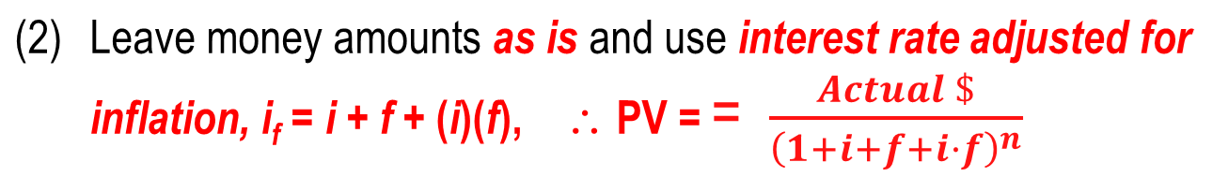
Understanding Inflation
Inflation: ________ in amount of money needed to purchase ____ amount
of goods or services. Inflation results in a in
purchasing power, i.e., one unit of money buys ________
goods or services
Two ways to work problems when considering inflation: (Fig. 14-1)
Convert to constant value (CV) dollars, then use real rate i.
If f = inflation rate (% per year), the equation is:
14-<number>

Slide 8
Example: Constant Value Dollars
How much would be required today to purchase an item that increased in cost by exactly the inflation rate? The cost 30 years ago was $1,000 and inflation has consistently averaged 4% per year.
Solution: Solve for future dollars
Future dollars = constant value dollars(1 + f)^{n}
= 1,000(1 + 0.04)³⁰
= $3,243
Note: This calculation only accounts for the ____________ purchasing power
of the currency. It does not take into account the time value of money
(to be discussed)
Deflation: Opposite of inflation; purchasing power of money is ________ in
future than at present; however, money, credit, jobs are ‘tighter’
14-<number>

Slide 9
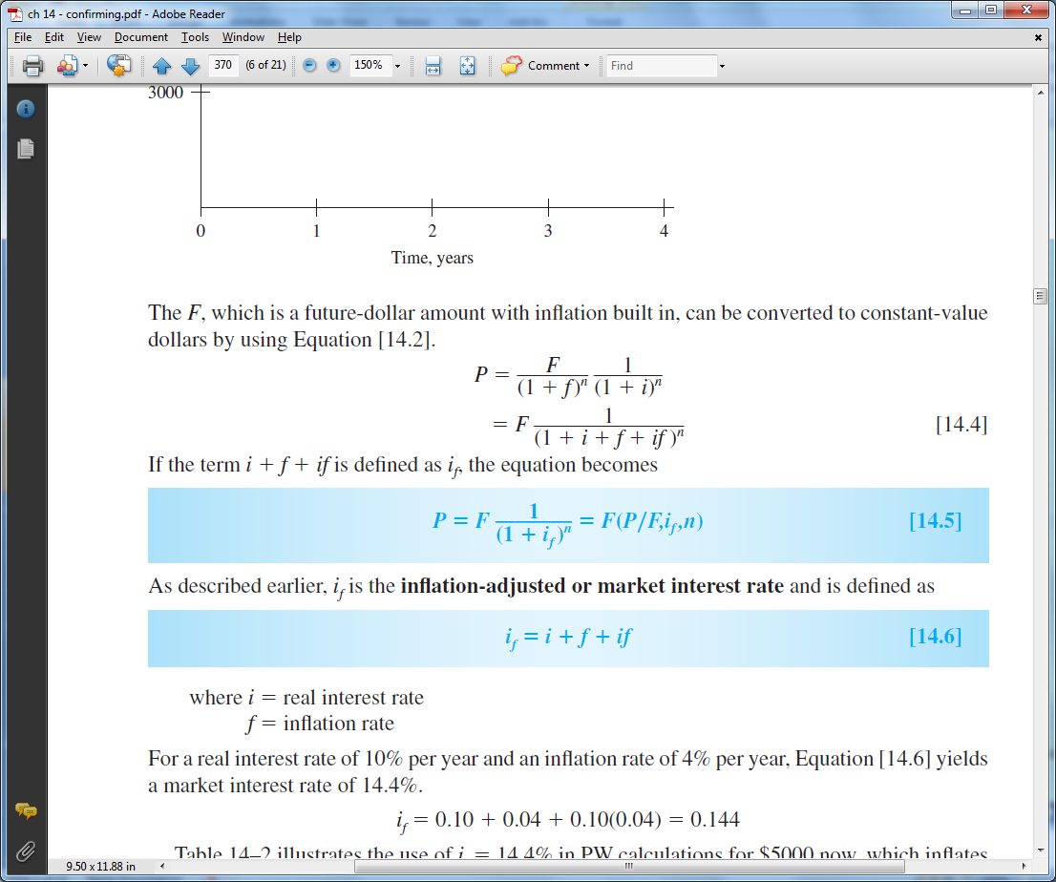
Three Different Rates
Real or inflation-free rate i – Rate at which interest is earned when effects of inflation are _______ ; i represents the real increase in purchasing power
Market or inflation-adjusted rate i_{f} – Rate that takes ___________ into account. Commonly stated rate everyday
Inflation rate f – Rate of change in value of currency
Relation between three rates is derived using the relation
_________ rate is: i_{f} = i + f + (i)(f)
14-<number>

Slide 10
Example: Market vs. Real Rate
Money in a medium-risk investment makes a guaranteed 8% per year. Inflation rate has averaged 5.5% per year. What is the real rate of return on the investment?
Solution: Solve for the real rate i in relation for i_{f}
i_{f} = i + f + (i)(f)
i_{f} – f
1 + f
0.08 – 0.055
1 + 0.055
0.024
Investment pays only ______% per year in real terms vs. the stated 8%
i =
=
=
14-<number>

Slide 11
PW Calculations with Inflation
Two ways to account for inflation in PW calculations
Convert cash flow into constant-value (___) dollars and use regular i
where: CV = future dollars/(1 + f)^{n} = then-current dollars/(1 + f)^{n}
f = inflation rate
(Note: Calculations up to now have assumed constant-value dollars)
Express cash flow in future (___________) dollars and use inflated
interest rate where i_{f} = i + f + (i)(f)
( Note: Inflated interest rate is the market interest rate)
14-<number>

Slide 12
Example: PW with Inflation
A honing machine will have a cost of $25,000 (future cost) six years from now. Find the PW of the machine, if the real interest rate is 10% per year and the inflation rate is 5% per year using (a) constant-value dollars, and (b) future dollars.
Solution: (a Determine _____________ dollars and use i in PW equation
CV = 25,000 / (1 + 0.05)⁶ = $18,655
PW = 18,655(P/F,10%,6)
= $10,530
(b) Leave as ___________ dollars and use i_{f} in PW equation
i_{f} = 0.10 + 0.05 + (0.10)(0.05) = 15.5%
PW = 25,000(P/F,15.5%,6)
= $10,530
14-<number>

Slide 13
FW Calculations with Inflation
FW values can have four different interpretations
(1) The actual amount accumulated
Use i_{f} in FW equation FW = PW(F/P, i_{f}, n)
(2) The purchasing power in terms of CV dollars of the future amount
Use i_{f} in FW equation and divide by (1+f)^{n} or use real i
where real i = (i_{f} – f)/(1 + f) FW = PW(F/P,i,n)
(3) The number of future dollars required to have the same purchasing
power as a dollar today with no time value of money considered
Use f instead of i in F/P factor FW = PW(F/P,f,n)
(4) The amount required to maintain the purchasing power of the present
sum and earn a stated real rate of return
Use i_{f} in FW equation FW = PW(F/P, i_{f}, n)
14-<number>

Slide 14
Example: FW with Inflation
An engineer invests $15,000 in a savings account that pays interest at a
real 8% per year. If the inflation rate is 5% per year, determine (a) the amount
of money that will be accumulated in 10 years, (b) the purchasing power of
the accumulated amount (in terms of today’s dollars), (c) the number of
future dollars that will have the same purchasing power as the
$15,000 today, and (d) the amount to maintain purchasing power and earn a
real 8% per year return.
Solution:
The amount accumulated is a function of the market interest rate, i_{f}
i_{f} = 0.08 + 0.05 + (0.08)(0.05) = 13.4%
Amount Accumulated = 15,000(F/P,13.4%,10)
= $52,750
14-<number>

Slide 15
Example: FW with Inflation (cont’d)
(b) To find the purchasing power of the accumulated amount deflate
the inflated dollars
Purchasing power = 15,000(F/P,13.4%,10) / (1 + 0.05)¹⁰
= $32,384
(c) The number of future dollars required to purchase goods that cost
$15,000 now is the inflated cost of the goods
Number of future dollars = 15,000(F/P,5%,10)
= $24,434
(d) In order to maintain purchasing power and earn a real return, money must
grow by the inflation rate and the interest rate, or i_{f} = 13.4%, as in part (a)
FW = 15,000(F/P,13.4%,10)
= $52,750
14-<number>

Slide 16
Capital Recovery with Inflation
The A/P and A/F factors require the use of i_{f} when inflation is considered
If a small company invests $150,000 in a new production line machine,
how much must it receive each year to recover the investment in 5
years? The real interest rate is 10% and the inflation rate is 4% per year.
Solution: Capital recovery (CR) is the AW value
i_{f} = 0.10 + 0.04 + (0.10)(0.04) = 14.4%
CR = AW = 150,000(A/P,14.4%,5)
= $44,115 per year
14-<number>

Slide 17
Summary of Important Points
Inflation occurs because ______ of currency has changed
Inflation _________ purchasing power; one unit buys less goods or services
Two ways to account for inflation in economic analyses:
Convert all cash flows into _______-value dollars and use i
Leave cash flows as inflated dollars and use _____
During _________, purchasing power of money is greater in future than at present
Future worth values can have four different interpretations, requiring different interest rates to find FW
Use ___ in calculations involving A/P or A/F when inflation is
considered
14-<number>

Slide 18
HOMEWORK
Please solve every Examples in your textbook. You do not have to submit your works.
Please upload following “PROBLEMS” solution file on “Assignment” menu in e-Class.
  14.29
  14.41
  14.56
  14.67
4-<number>

